Slide 1







Software University: Learning Program
Become a Software Engineer and Start a Job
SoftUni Team
Technical Trainers
Software University
https://softuni.bg

Slide 2
Table of Contents
Welcome to SoftUni
SoftUni Partners
SoftUni Trainers
Learning Paths and Opportunities

Slide 3
Questions?
sli.do
#fund-common

Slide 4
The SoftUni Family
Quality Digital Education for Thousands

Slide 5
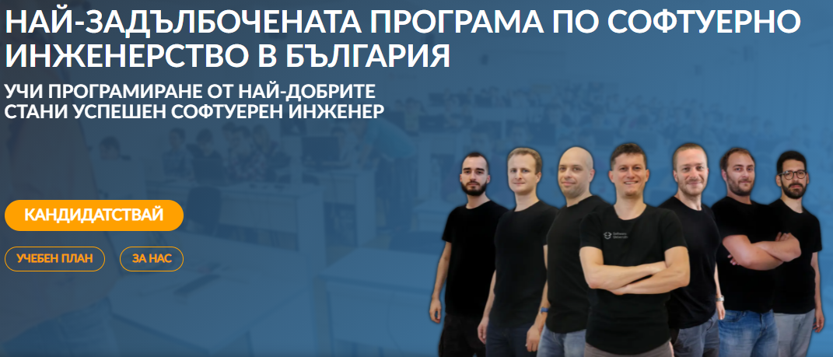
Software Engineering Learning Program
The "Software University" learning program @ SoftUni
Become a professional software engineer in ~ 1-2 years
Professions:
C# / .NET Web Developer
Java & Spring Web Developer
JavaScript Web Developer
Python & Django Web Developer
Curriculum: https://softuni.bg/curriculum

Slide 6

SoftUni Partners
Tech Companies, Who Support SoftUni

Slide 7













SoftUni Diamond Partners

Slide 8

Educational Partners

Slide 9
Coca-Cola HBC – Bulgaria
Coca‑Cola HBC is one of the world's largest bottlers of brands from the Coca‑Cola company
CCHBC started operations in Bulgaria in 1992 and since then is one of the biggest contributors to the local economy
Global company with over 30 thousand engaged people
https://bg.coca-colahellenic.com

Slide 10

CreateX
Site design
Website optimization – SEO
Online advertising – PPC
Social media marketing
Copywriting
Creative concept and design
https://createx.bg/

Slide 11

Postbank
One of the top banking institutions in Bulgaria
Employer of the year for 2017
Member of the Eurobank Group with € 58 billion of assets
Serious investments in digitization
The first bank credit botchat – EVA
https://www.facebook.com/evapostbank
https://www.postbank.bg/Za-nas/Careers

Slide 12
SuperHosting
The largest hosting company in Bulgaria
Hosting & Domains
WordPress Hosting
VPS Servers
SSL Certificates
E-Commerce
Top-quality support
Top-qualified team
Offering a complete solution
Leading technical equipment
https://www.superhosting.bg/

Slide 13
SmartIT
Established in 2005
Developing their own Fintech software tools
Technological hub of MFG with a focus
to establish a new generation platform Smart Check
Using C#, .Net Core, Web API, Microservices, Kubernetes, React, JS, JQuery, MS SQL
Looking for Devs & QAs
https://www.smartit.bg

Slide 14
Draft Kings
US-based award-winning tech company
Has a team of over 3900 talented
engineers across the globe
Works with innovative technologies to deliver high-quality sports entertainment products to their clients
Offices in Sofia and Plovdiv
https://careers.draftkings.com/jobs/

Slide 15

Indeavr
Business and technology services company
Business application development
Infrastructure services
Collaboration services
Looking for trainee and junior .NET Developers
https://www.indeavr.com/en/careers

Slide 16

Taulia
Global FinTech platform
Microservices, CI/CD, Autonomous teams
Java-based stack, open to developers with any tech background
https://taulia.com/company/careers/

Slide 17



Software Group
Integration solutions for financial institutions
Provide digital transformation
https://www.softwaregroup.com/
Discovering Potential
Driving Innovation
Unlocking Opportunities

Slide 18

Schwarz IT
IT service providers for the divisions of the Schwarz Group
Responsible for the provision of IT infrastructure platforms and business applications
Support education and invest in development of business and IT professionals
https://it.schwarz/en/it-hubs/bulgaria

Slide 19

PokerStars
Product company home of PokerStars, PokerStars Casino and PokerStars Sport
Global engineering team
Industry-leading products
Java, JS, React, Kubernetes, AWS and many more
https://pokerstarscareers.com/

Slide 20
PharVision Capital
Founded in 2020 in Chicago
Provide superior uncorrelated investments returns using statistics and AI/ML methods
Sources un/structured datasets, sound economic and financial principles, and advanced ML techniques to capture in the equity markets
https://www.pharvision.ai/

Slide 21
Bosch.IO
Bosch.IO drives the digital and
AIoT business of Bosch Group
Around 900 associates, more than 200
of whom are working in the Bulgarian office
Languages and frameworks: Java, Spring Boot, Go, TypeScript; Mobile: iOS & Android; Cloud Platforms: Azure & Azure DevOps, AWS
https://bosch.io/

Slide 22

The Trainers
The Trainers for the Software Engineering Program

Slide 23
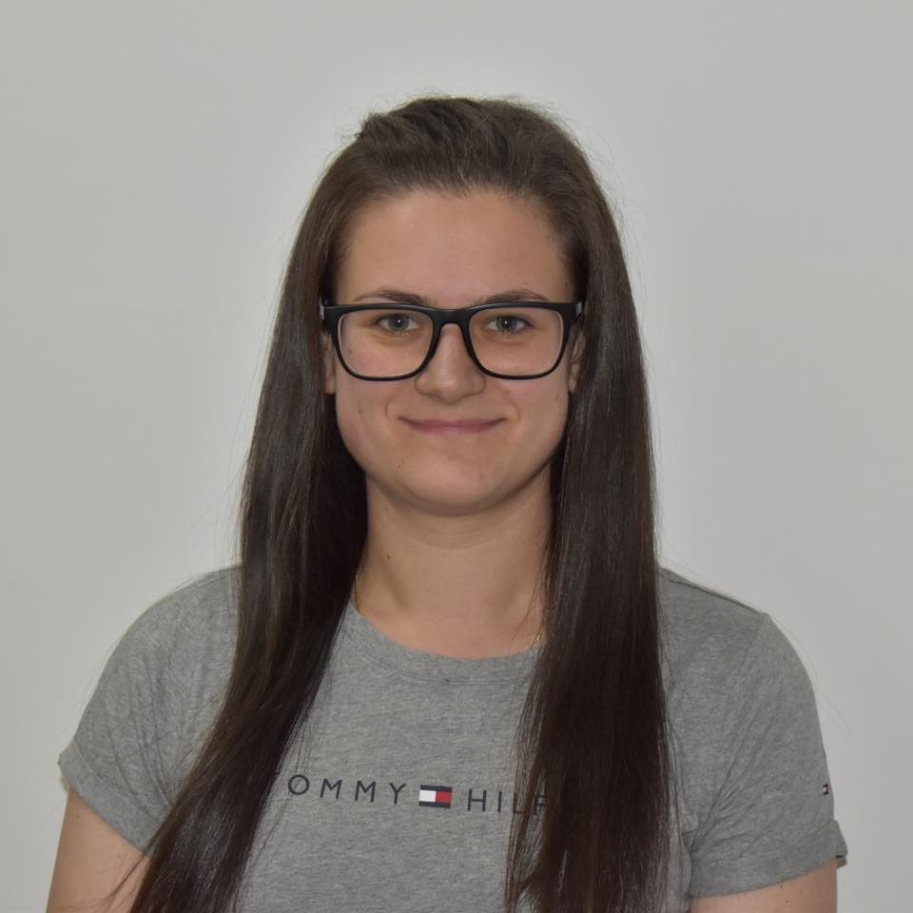
Desislava Topuzakova
Senior Java Developer & Scrum Master @SAP
Ex-competitor in Mathematics
Technical Trainer @SoftUni
Programming Basics Team Lead
Content Development Team Lead

Slide 24

Veronika Vaneva
Former Training Director @ SoftUni
Project Manager @ Information Services AD
Former Program Director @ Motion Software
Graduated from the Medical University - Pleven
Interests in Java, C++ and Unity

Slide 25
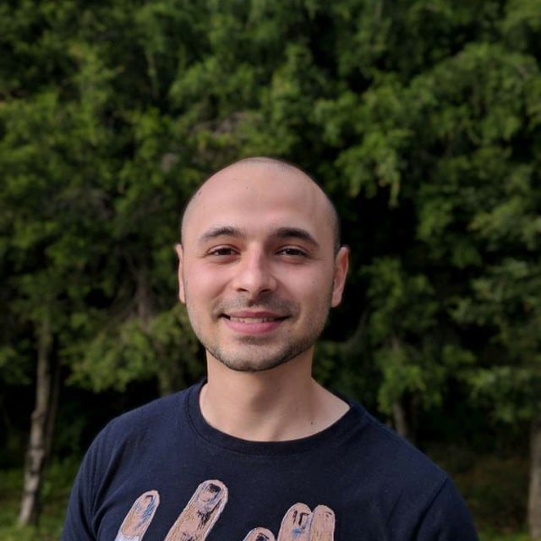
Stoyan Shopov
Senior Software Engineer @ Grand Games
Technical trainer @ SoftUni
Microsoft Certified Trainer & Public Speaker
Experience with ASP.NET, Azure,
Unity and others
Mentored @ SoftUni Bootcamp
Worked @ Siemens, SoftUni, Indeavr and Cobuilder

Slide 26
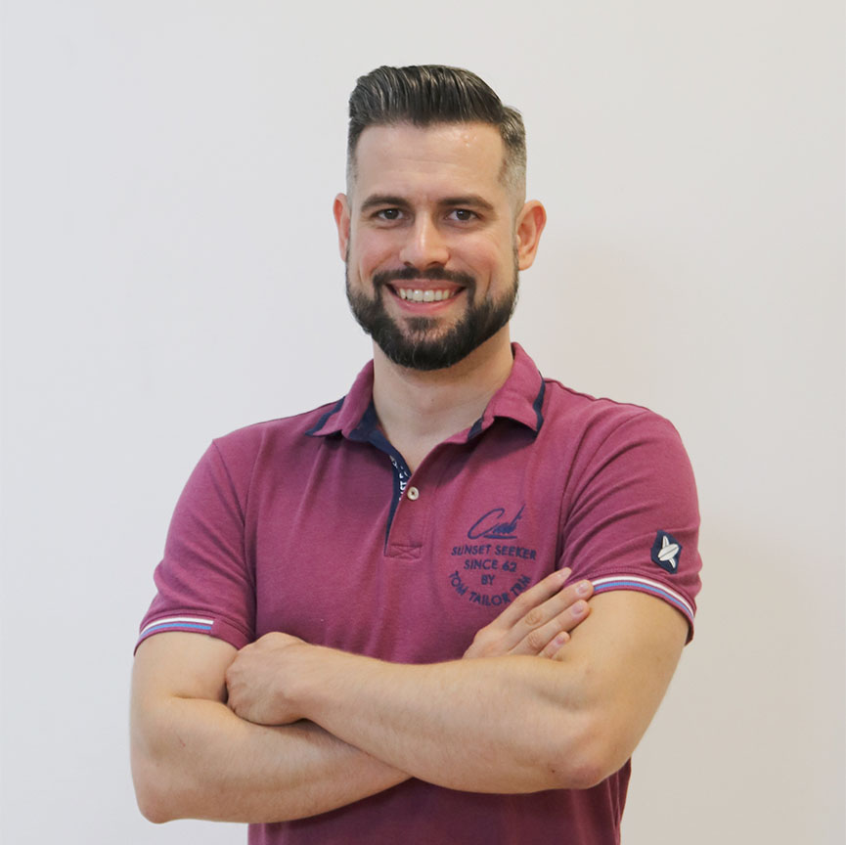
Ivaylo Papazov
Senior Software Engineer at Payhawk
Trainer at SoftUni
Experience with JS, React, Node.js, MongoDB
6+ years professional experience

Slide 27
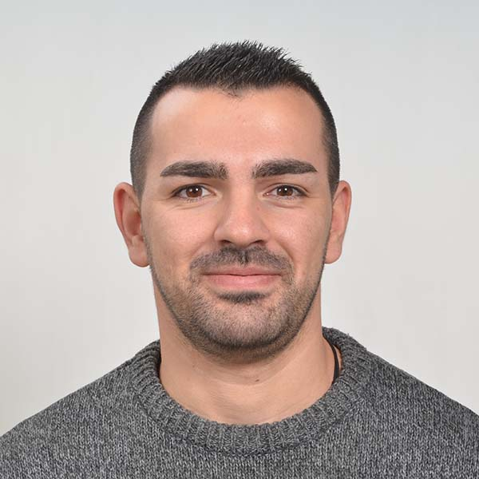
Mario Zahariev
Top student at SoftUni
Master of Cyber Security
3+ years of experience on Python
Interested in JavaScript, Artificial Intelligence and Go
Involved in researches related to artificial intelligence and machine learning

Slide 28
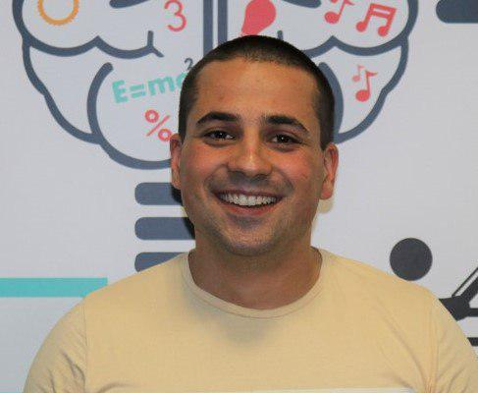
Martin Paunov
Java Developer @ VMware
Experience with Java, C++, C#
Technical Trainer @ SoftUni
Interested in Astrophysics

Slide 29
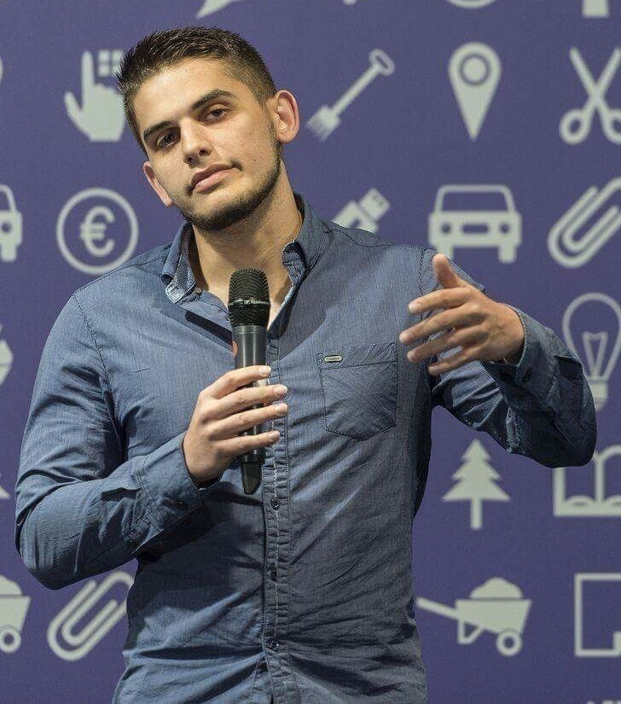
Viktor Dakov
Senior Developer SDE 3, Nuvolo
Worked at Amazon
John Atanasoff award
Participated in many programming contests
6+ years of experience as a developer

Slide 30
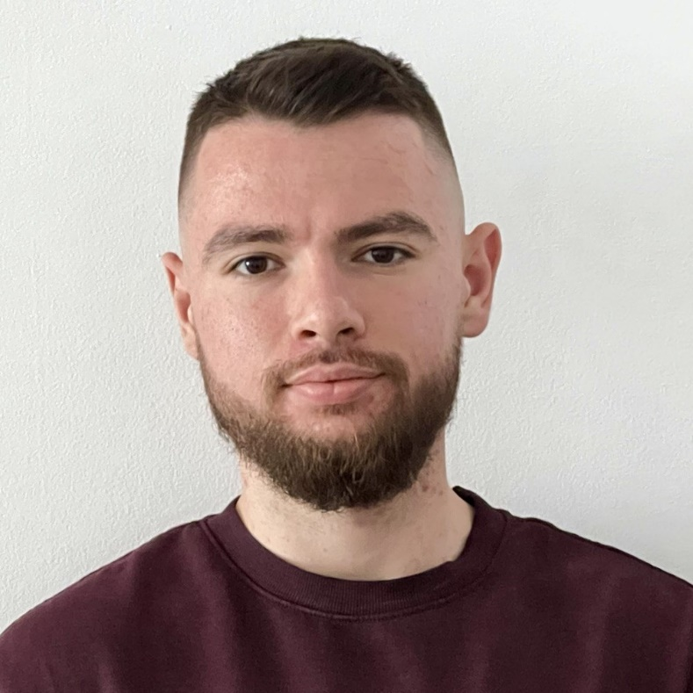
Atanas Atanasov
Software Engineer at Nexo
World's leading regulated digital assets institution
Created in Bulgaria
Technical Trainer at SoftUni
200+ training sessions for 4 years
Interested in the blockchain development
30

Slide 31
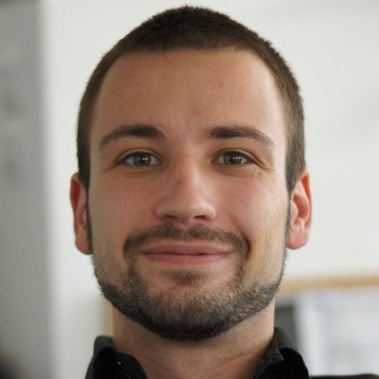
Angel Georgiev
Educational Director at SoftUni
15+ years of experience as a Technical Trainer and a Product Presenter
Founder and Business OWL at Znam.bе
Fluent in Java, C#, HTML/CSS, JavaScript, Python, PHP, SQL

Slide 32
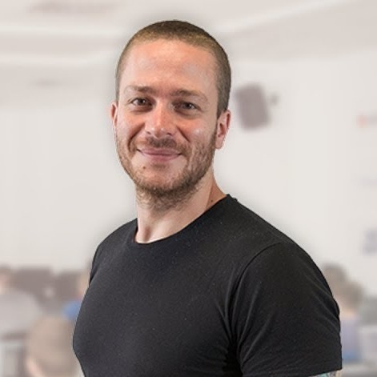
Ivaylo Kenov
Various job titles at the same time:
CTO @ SoftUni
Technical Trainer @ SoftUni
Creator of the most detailed software architecture course
Mathematical competitions champion
Contacts:
https://github.com/ivaylokenov
https://linkedin.com/in/kenov

Slide 33
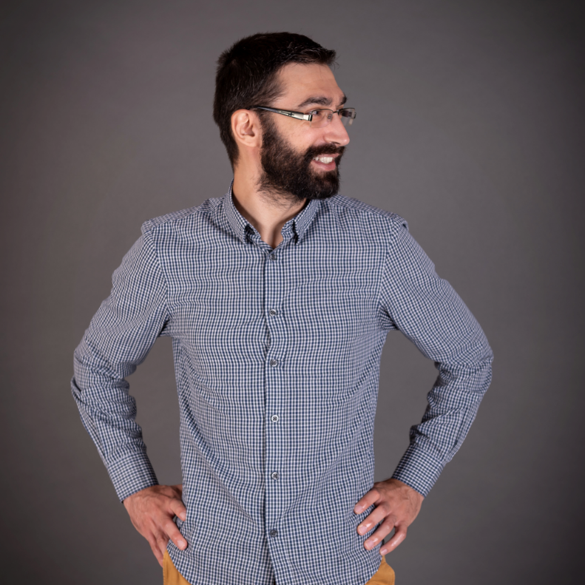
Viktor Kostadinov
Senior technical trainer with 5 years experience in the IT field
Head of the R&D Unit at Software University
Former Director of the Education Department
JavaScript enthusiast

Slide 34
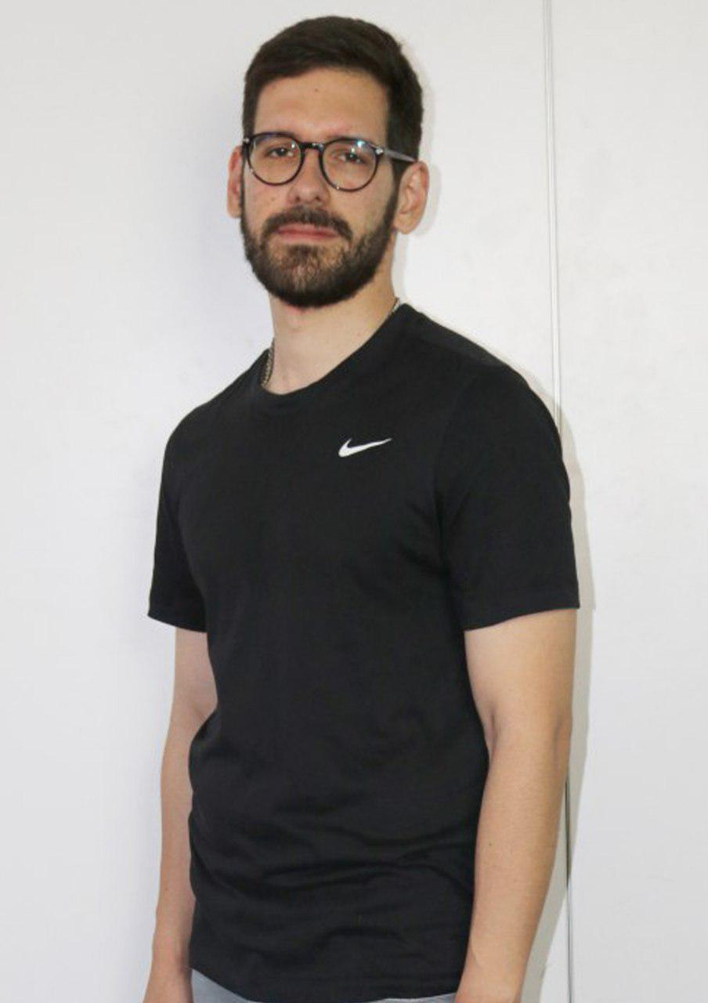
Ilia Idakiev
Software developer-entrepreneur
Co-Founder @ HILLGRAND
Google Developer Expert
Co-organizer of Angular Sofia and SofiaJS / BeerJS
Lecturer at Sofia University (FMI)
"Advanced JavaScript" course

Slide 35
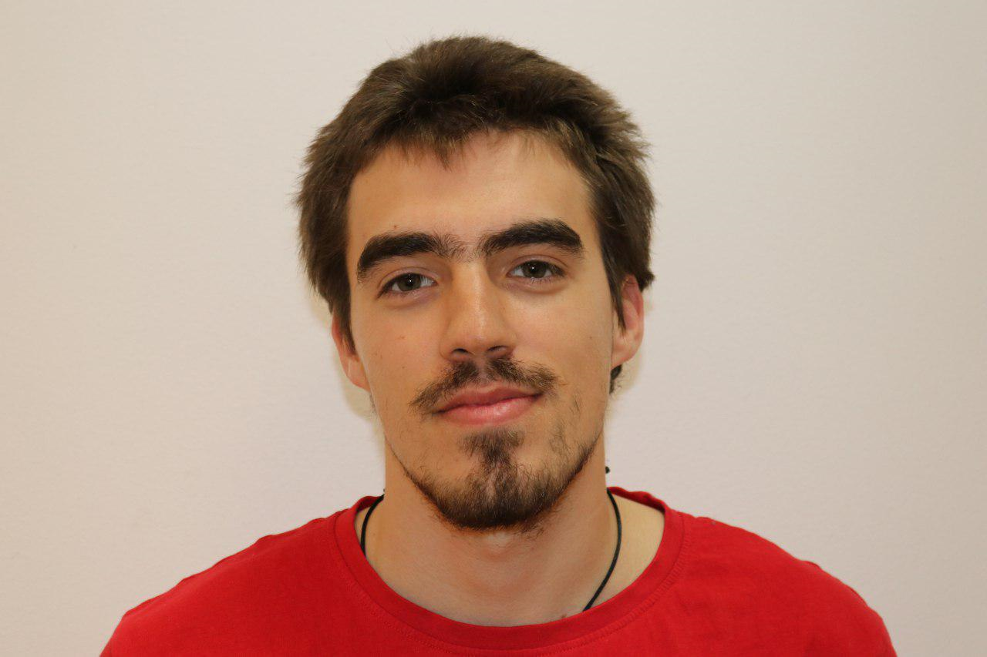
Nikolay Bankin
Software Engineer with many years of experience with various technologies
Teacher at TUES
Many years of experience as a Trainer
He has worked with Scala, Akka, Java and JavaScript

Slide 36
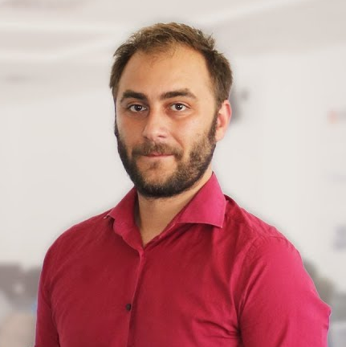
Doncho Minkov
Technical lead, Architect and DevOps @ SoftUni
10+ years of experience as a Technical Trainer
Front-end developer by heart
Software developer by need
Experienced in Django, Node.js, .NET and others
Fluent in Python, JavaScript, C#, Java, C++
"30 under 30" – Forbes 2017 - Education

Slide 37
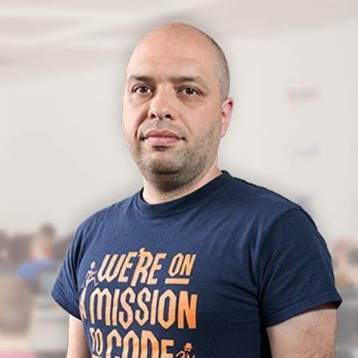
Stamo Petkov
Head Of Department at Information Services Plc.
Worked with various technologies
.NET and C#, BASIC, Pascal, Object Pascal, PHP
More than 15 years of experience
Experienced Lecturer
C# Basics and ASP.NET MVC @ Softuni

Slide 38
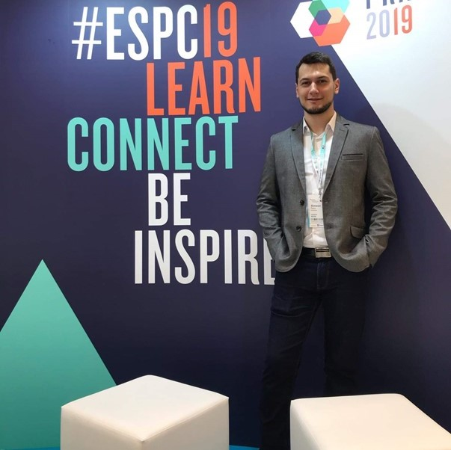
Simeon Petrov
Front-end Developer @ Blubito AG
Passionate about Vue, JavaScript & CSS
Experienced with Vue, React, Gatsby, Svelte, Angular
Getting involved more with NodeJS & Python

Slide 39

Learning Paths and Opportunities
The Choice is Yours

Slide 40
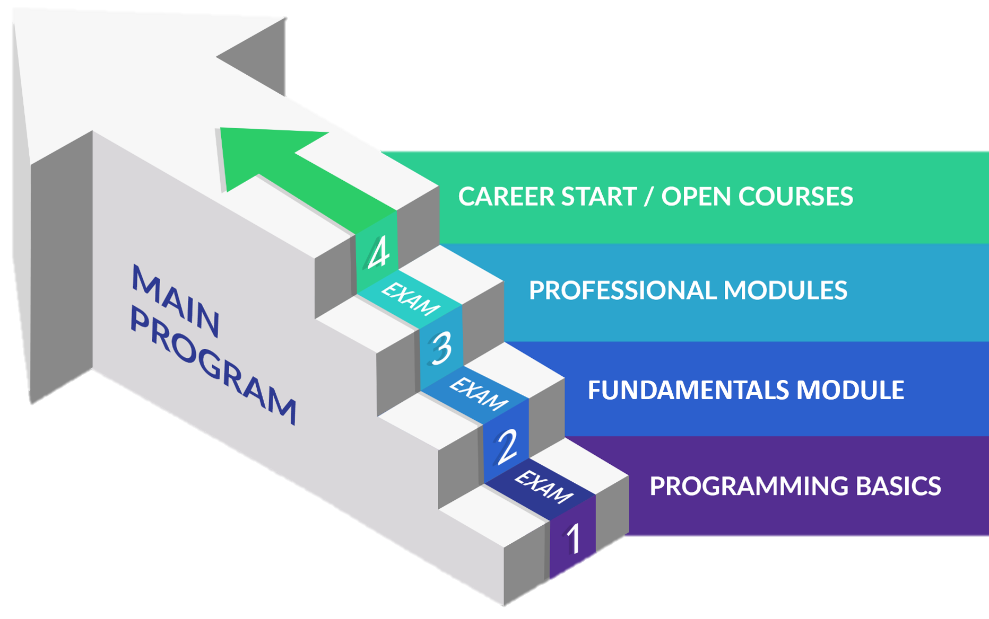
Software Engineering: Educational Program
Learning tracks: C#, Java, JavaScript, Python

Slide 41
Curriculum
Entry Module
Programming Basics
2 months
Fundamentals Module
Programming Fundamentals
4 months
Professional Modules
Java
C#
Python
JS
12-16 months
https://softuni.bg/trainings/courses

Slide 42
Questions?
Notes:
42

Slide 43
Trainings @ Software University (SoftUni)
Software University – High-Quality Education, Profession and Job for Software Developers
softuni.bg, about.softuni.bg
Software University Foundation
softuni.foundation
Software University @ Facebook
facebook.com/SoftwareUniversity
Software University Forums
forum.softuni.bg
Notes:
43

Slide 44

License
This course (slides, examples, demos, exercises, homework, documents, videos and other assets) is copyrighted content
Unauthorized copy, reproduction or use is illegal
© SoftUni – https://about.softuni.bg/
© Software University – https://softuni.bg
Notes:
44

